Slide 1




NEXT GEN EMPLOYABILITY PROGRAM
Creating a future-ready workforce
Team Members
College Name
Student Name :S.Vijayalakshmi
Student ID : au814721104060
SRM TRP ENGINEERING COLLEGE

Slide 2

CAPSTONE PROJECT SHOWCASE
Project Title
Notes Sharing Web Application using Django Framework
Abstract | Problem Statement | Project Overview | Proposed Solution | Technology Used | Modelling & Results | Conclusion

Slide 3
Abstract
This project aims to develop a Notes Sharing Web Application using the Django framework, a high-level Python web framework known for its simplicity and versatility. The application allows users to create, edit, delete, and share notes with other users in a collaborative environment.
Source :

Slide 4
Problem Statement
Develop a web application that allows users to create, share, and manage their notes online. The application should be built using the Django framework to ensure scalability, security, and ease of maintenance
.Note Creation: Users should be able to create new notes with a title, content, and optional tags for organization
Note Sharing: Users should have the ability to share their notes with other registered users, either publicly or privately.
Source :

Slide 5
Project Overview
Introduction: Briefly introduce the purpose of the application, which is to provide users with a platform to create, organize, and share notes.Features:• User Authentication: Allow users to sign up, log in, and manage their accounts.
• Create Notes: Users can create new notes, add titles, descriptions, and content.
• Share Notes: Users can share their notes with others by generating unique URLs or inviting specific users.☆Architecture:
• Frontend: Use HTML, CSS, and JavaScript for the user interface. Utilize frameworks like Bootstrap for responsive design.
• Backend: Django framework for building the application logic, managing data, and handling user authentication.
Source :

Slide 6
Proposed Solution
.
● Project Setup: Install Django and create a new project using the django-admin command.
● App Creation: Create a Django app within the project to handle the notes functionality.
● User Authentication: Implement user authentication using Django's built-in authentication system or a third-party package like Django framework
● Views: Create views to handle CRUD (Create, Read, Update, Delete) operations for notes.
● Templates: Design HTML templates for user interface components like note listing, note creation, note editing, etc.
● Deployment: Deploy the application to a web server. Options include platforms like Heroku, AWS, or deploying on your own server.
Source :

Slide 7
Modelling & Results
● User Model: Represents users, typically provided by Django's built-in authentication system.
● Note Model: Contains fields like title, content, date created, and a foreign key relationship with the User model to associate notes with users.
Result:Users can sign up, log in, and create notes.
This results in a functional and secure Notes sharing web application where users can manage their notes effectively.
Source :

Slide 8


Technology Used
Front-end
Back-end
Source :

Slide 9
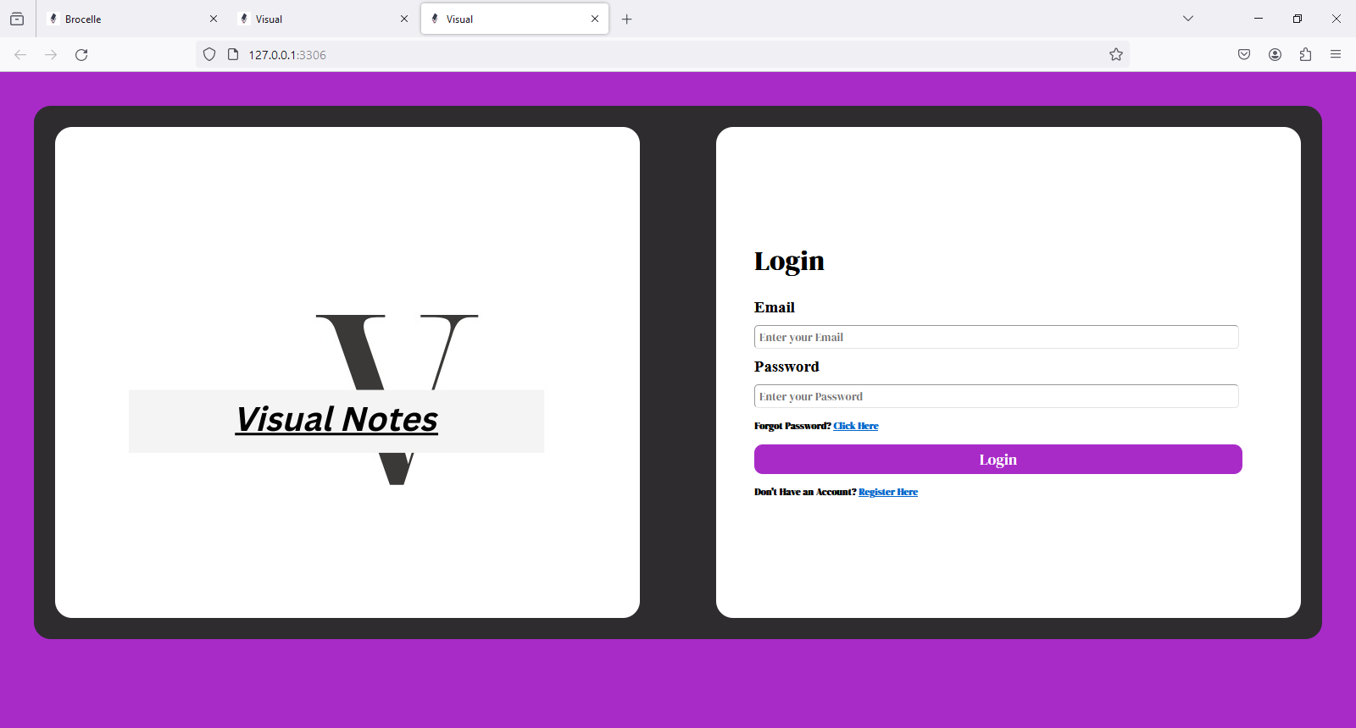
Student login

Slide 10
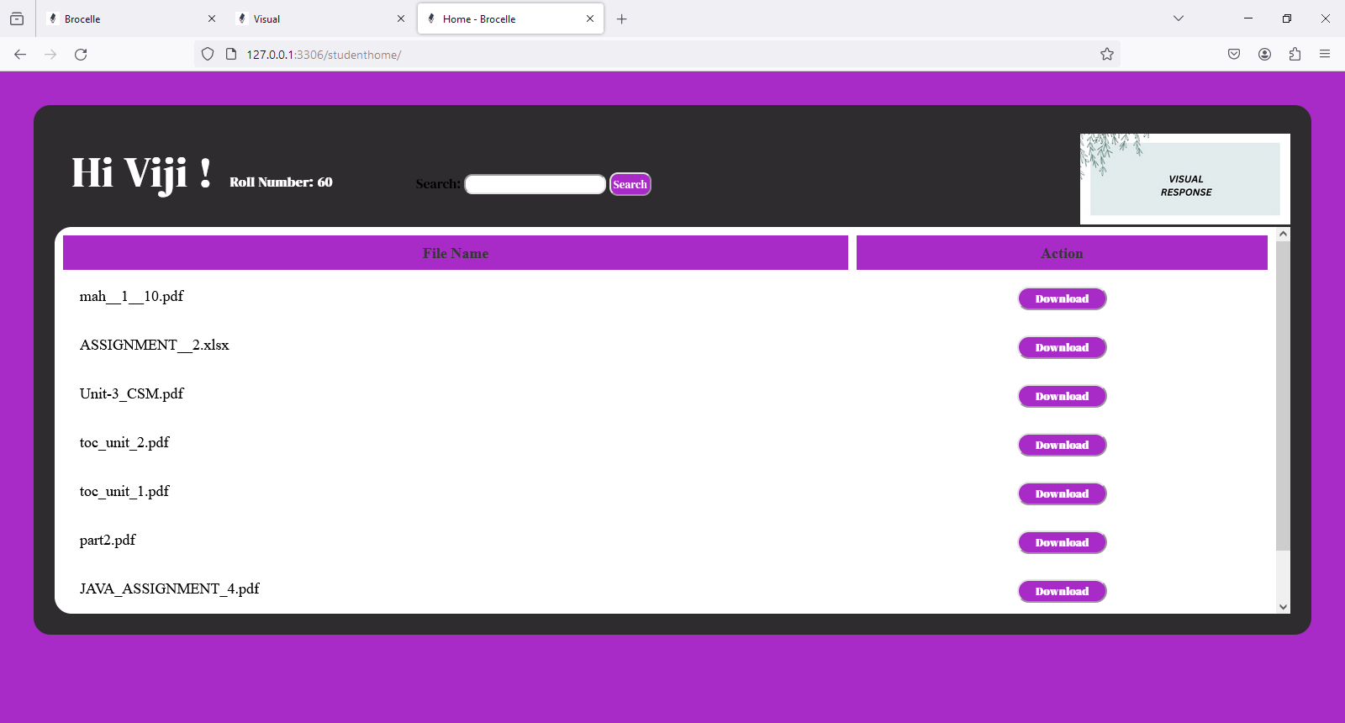
Student page

Slide 11
Teacher login

Slide 12
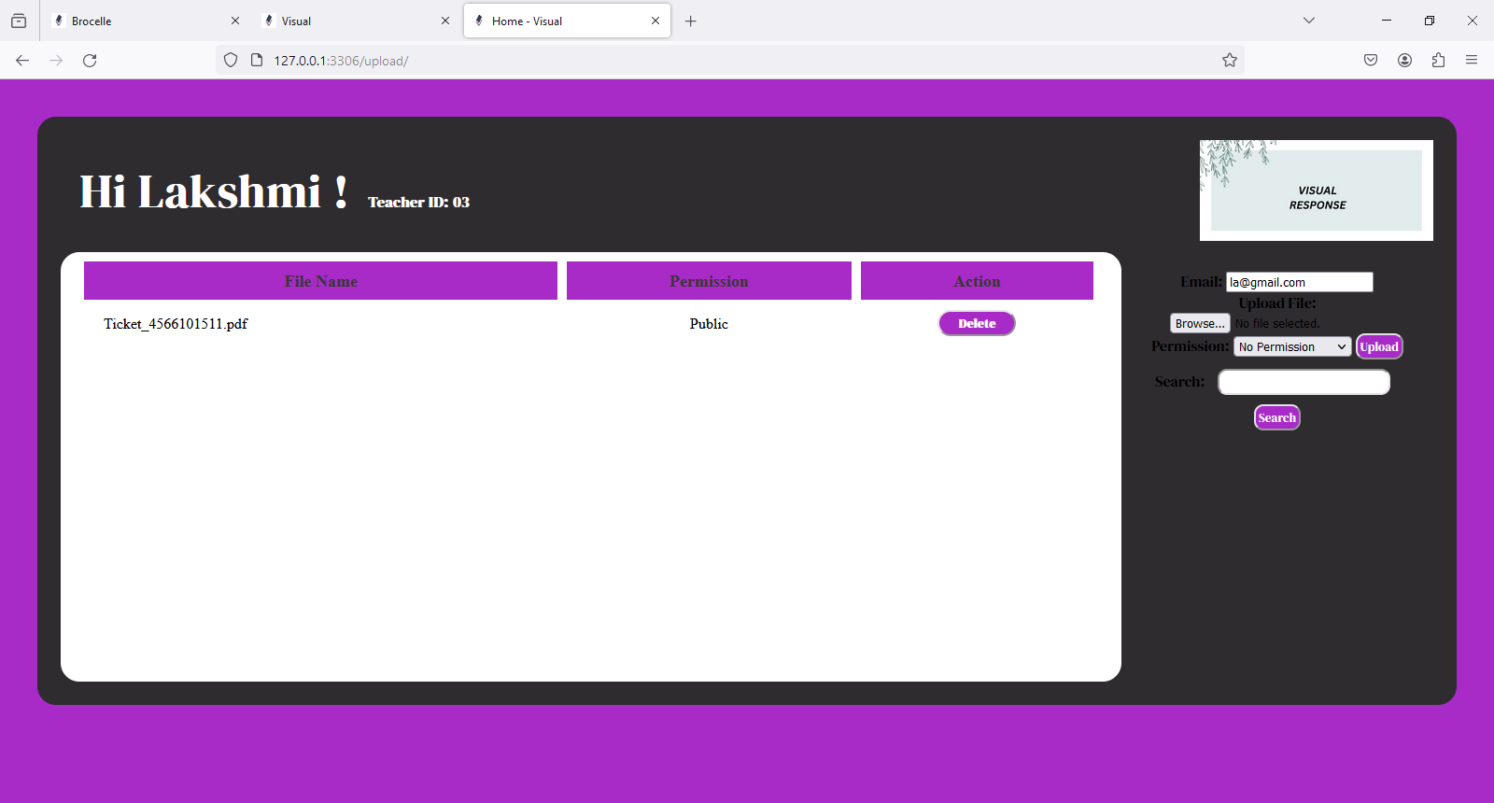
Teacher’s page

Slide 13
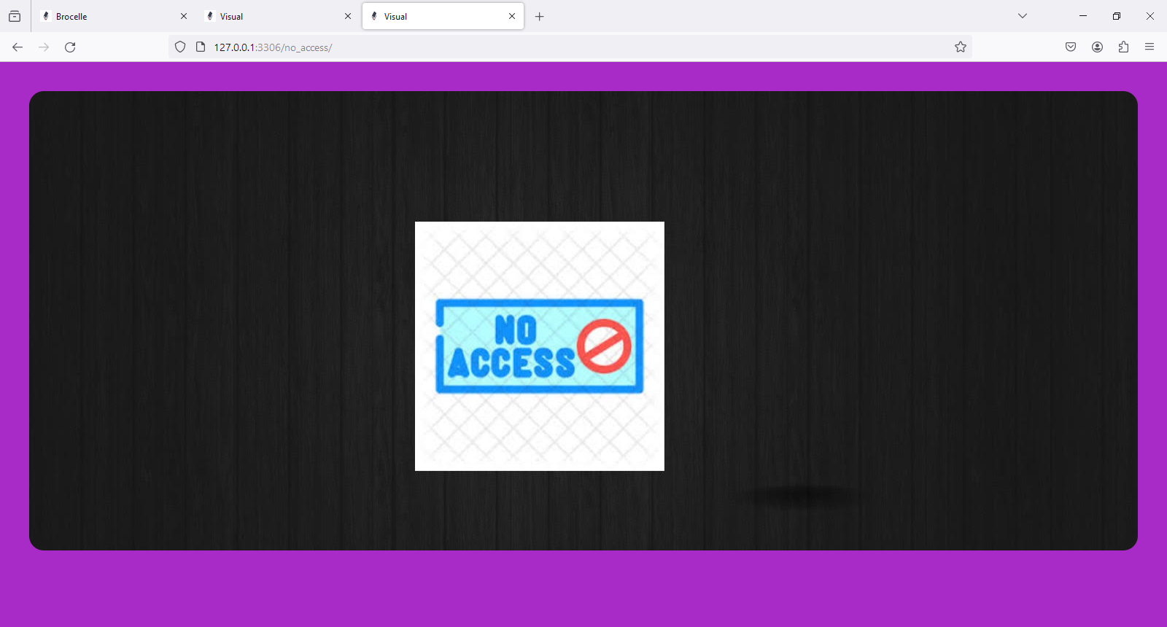
No access

Slide 14
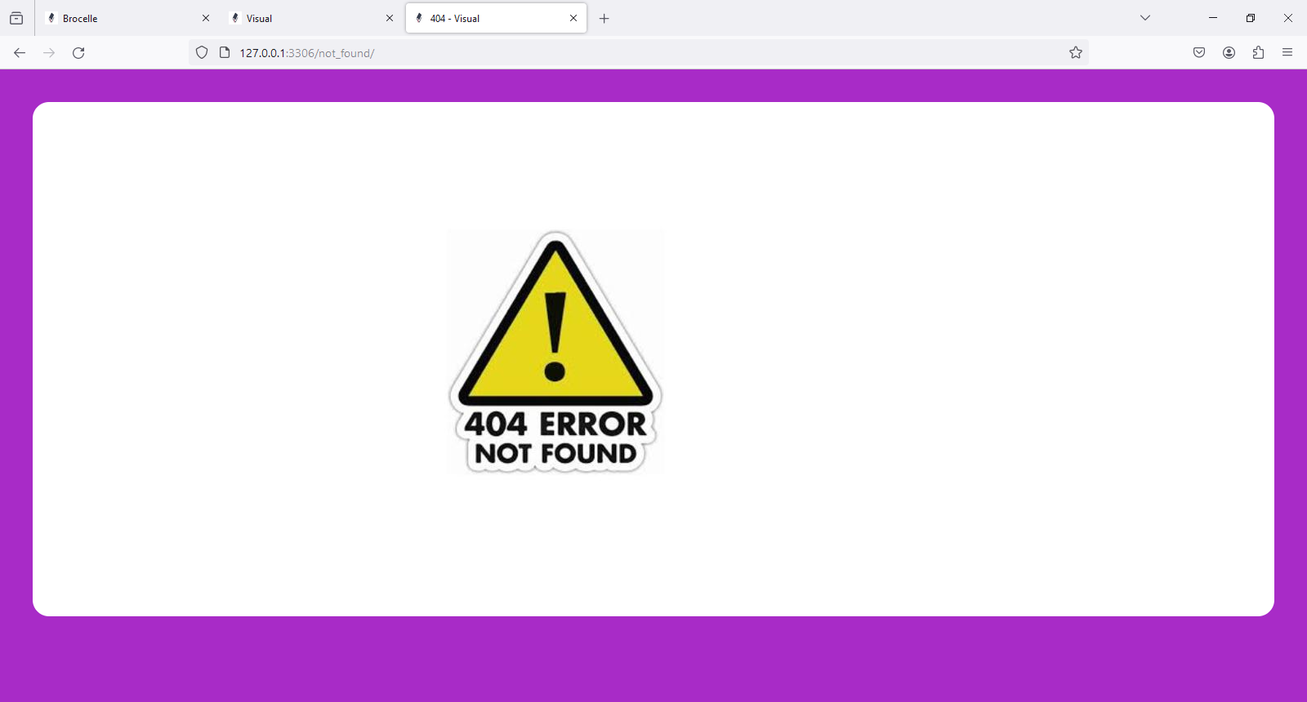
404 Error

Slide 15
Future Enhancements:
The main technologies used in a Notes sharing web application:Django: High-level Python web framework for rapid development.HTML/CSS/JavaScript: Frontend technologies for user interface and interactivity.SQLite/PostgreSQL/MySQL: Database management systems supported by Django for storing notes and user data.

Slide 16
Conclusion
In conclusion, developing a Notes sharing web application using the Django framework offers a robust and efficient solution
Source :

Slide 17
Conclusion
In conclusion, developing a Notes sharing web application using the Django framework offers a robust and efficient solution
Source :

Slide 18
Thank You!
Notes:
Thank You !!

